Slide 1

VHS Corp

Slide 2
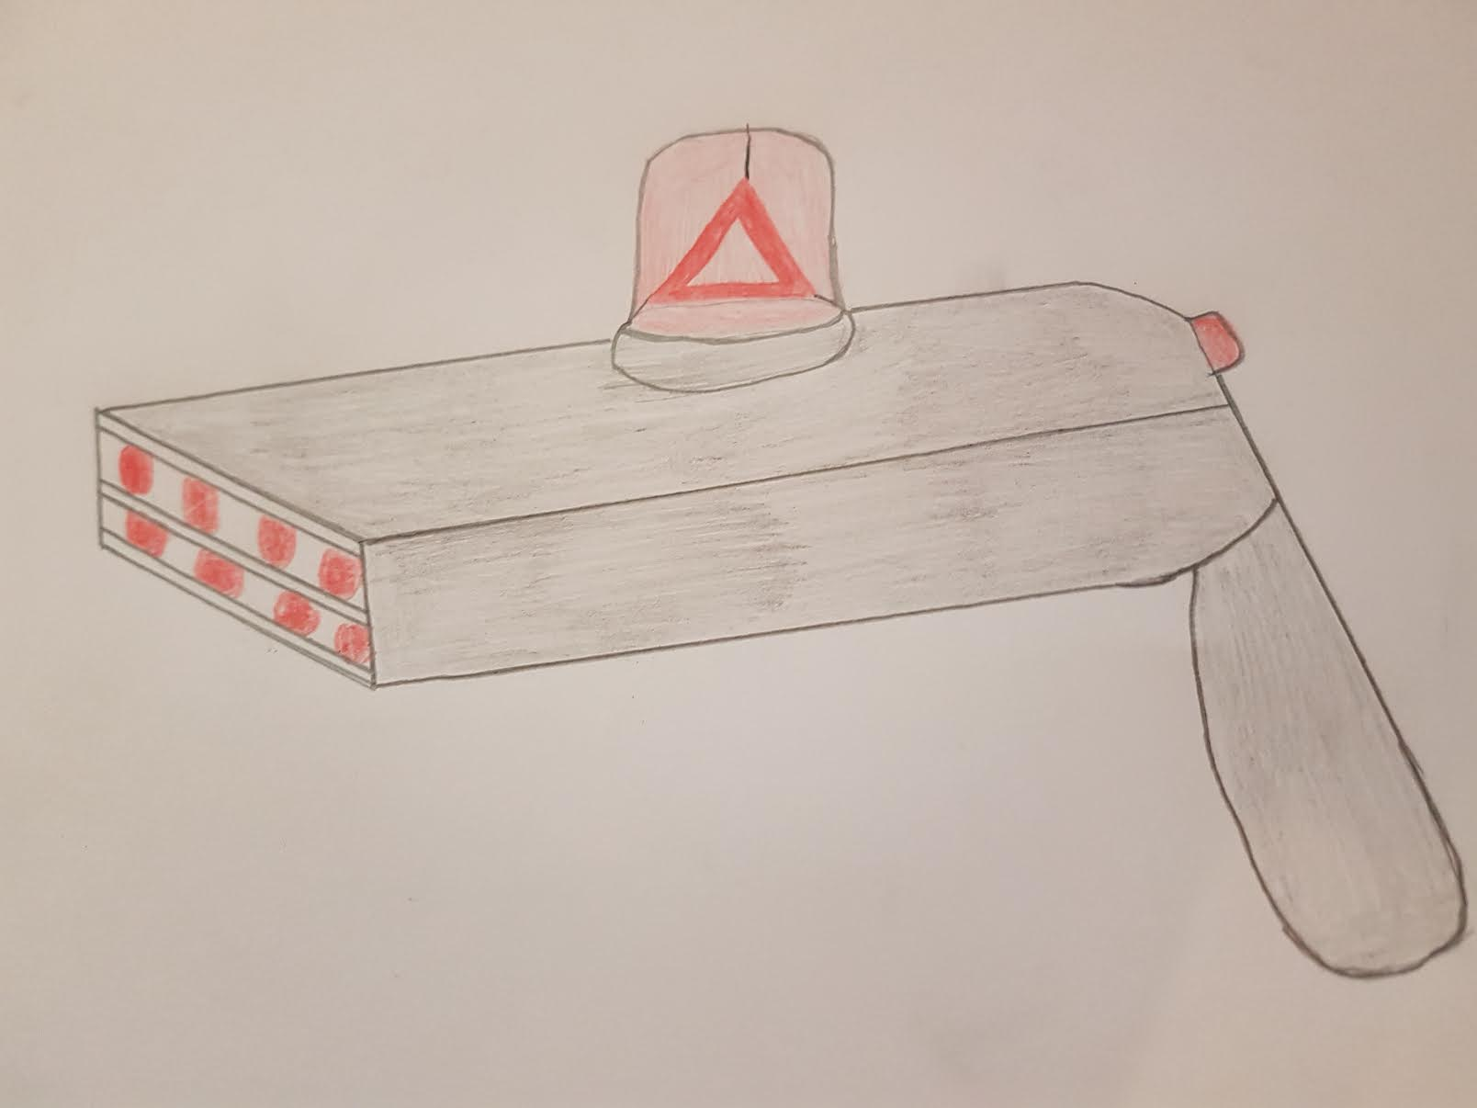
The Transdimensional Pistol

Slide 3
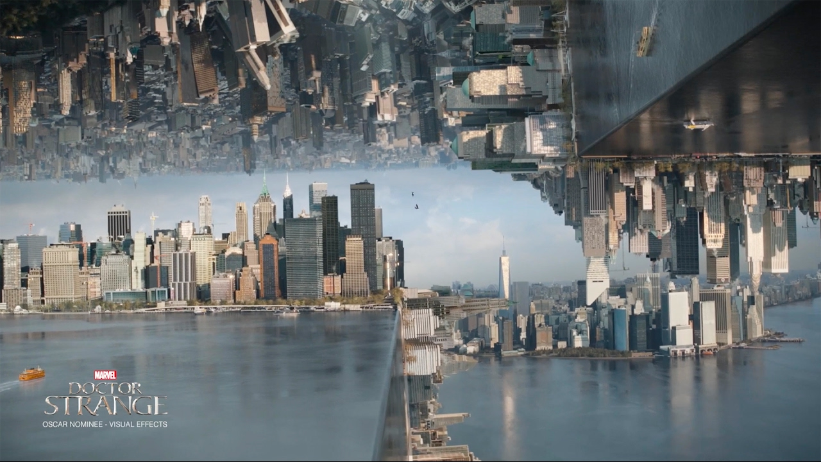

Slide 4


